Slide 1
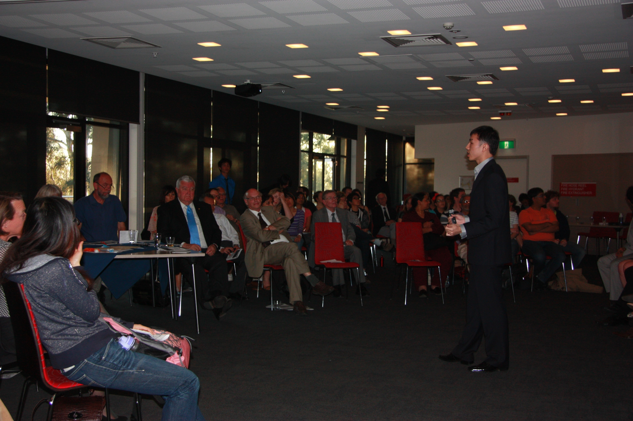
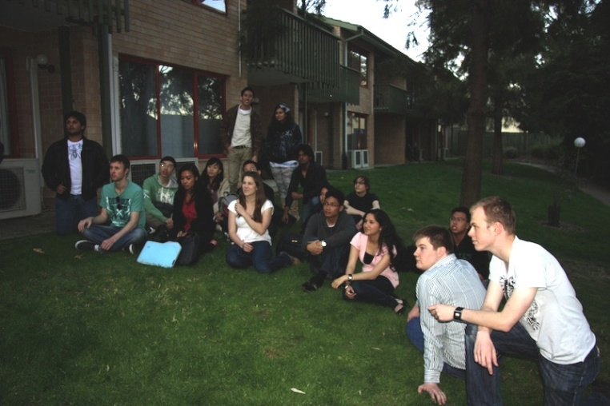
The Global Cross-Disciplinary Tournament
Proposal for the 2011 IARU Senior Officers’ Meeting

Slide 2
The Global Cross-Disciplinary Tournament, GXT:
cross-university cross-disciplinary
Students
competing in teams
to tackle global challenges,
using online communication
to do research,
proposing change at a public symposium.
Cost? Two options:
Six flights to Singapore, or
No money – just your help

Slide 3

GSP students want to create an IARU global student community.
We have the online technology. What we need is a motivation.

Slide 4
July
August
September
October
November
December
GSP
Selection
internationally-coordinated student-led competitions
Development
online teamwork, IARU research theme
Residential
workshops & seminars, public Symposium

Slide 5
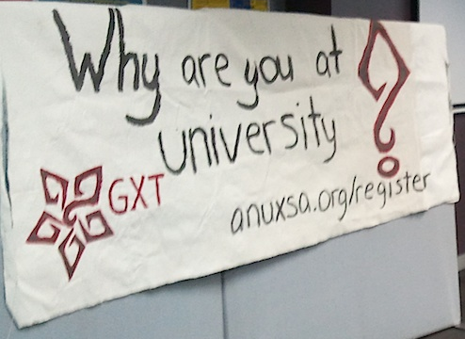
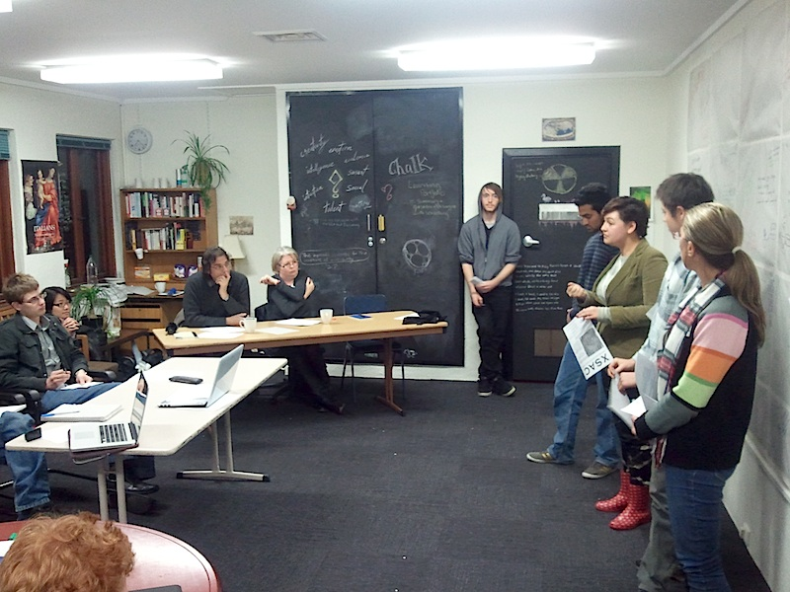
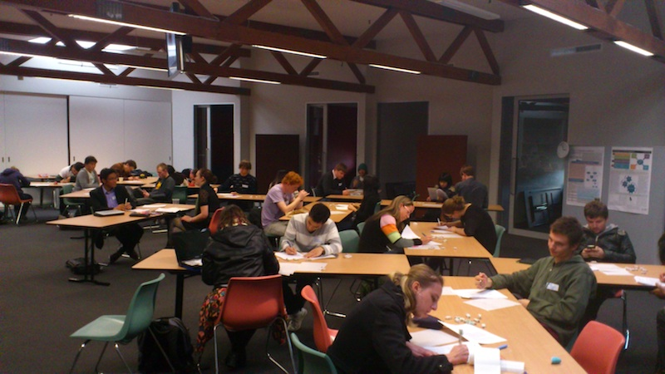

Slide 6
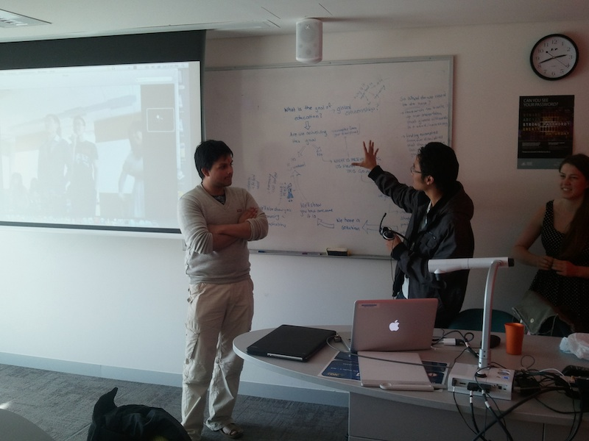
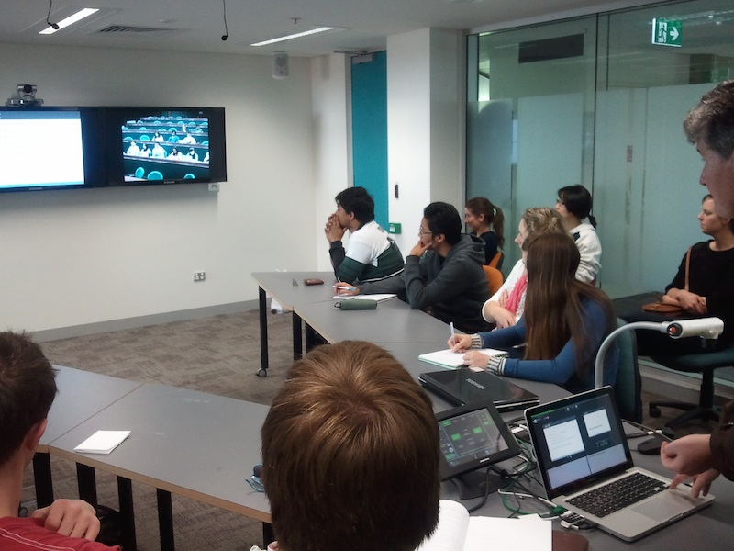

Slide 7
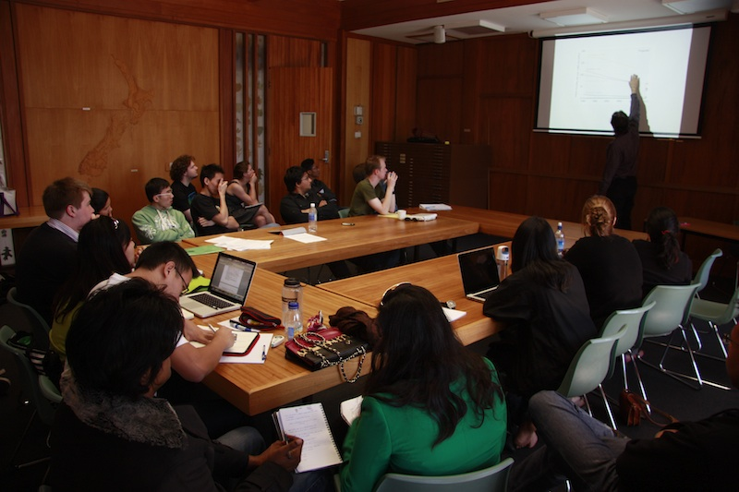
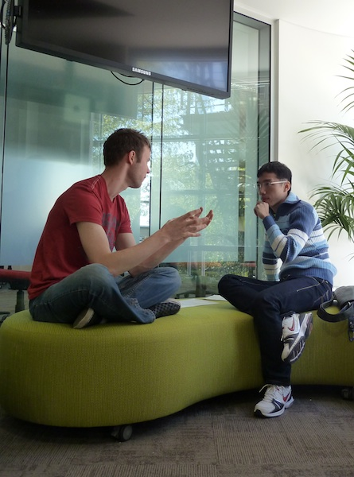
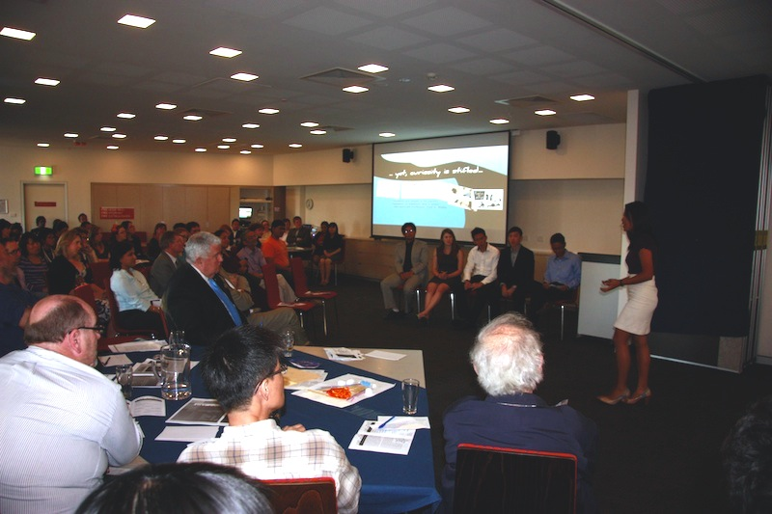

Slide 8
Indicators of Success:
Independent academics sought to implement two of the three proposals after the symposium
The participants continue to discuss education a month later on the GXT2011 Facebook Page

Slide 9
Indicators of Success – survey:

Slide 10
“… it's like a GSP trip (which, until GXT, was the most awesome experience of my life), but with a purpose!”
“We are faced with world problems that are complex in nature and will require us to work together across disciplines to find solutions. I think this program really encouraged us to think on a global scale; and to think not only outside the box but as though we didn't know there was a box at all.”
“IARU is such a fantastic platform for a tournament like the GXT. We've seen that virtual communication and online collaboration can work, and can work well.”
“I don't think there's any coming back from that experience, and the incredible bond formed between all the participants.”

Slide 11
Plan for 2012
University Scholars Programme at NUS enthusiastic to host in 2012
2011 participants keen to be student organisers

Slide 12
Two options to be involved:
Full Participation
Fund six airfares
Your students form the teams for the tournament
Online Participation
No significant cost
Encourage GSP students to support their friends in the teams online

Slide 13
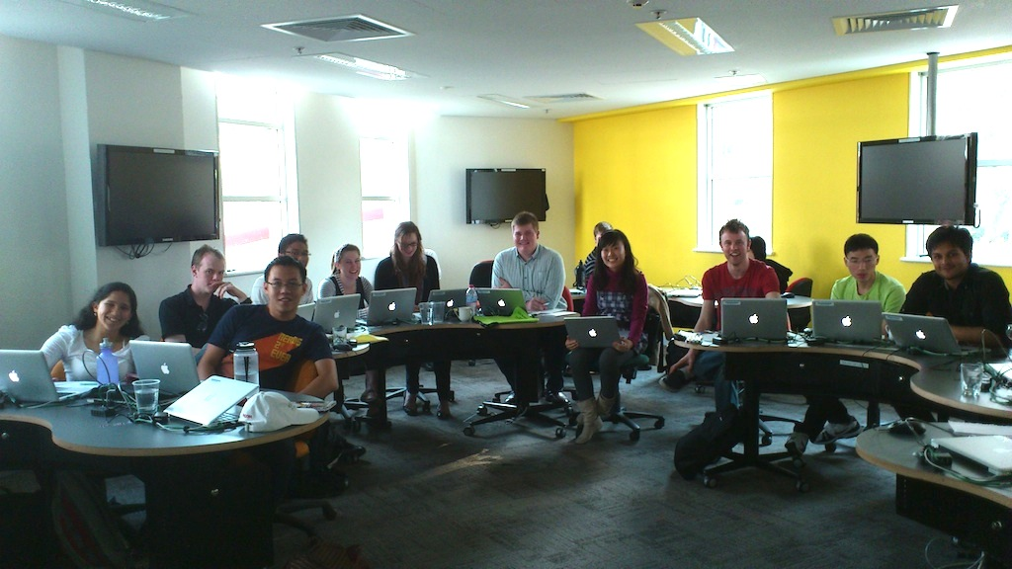
The GXT would bridge cultural and academic differences through competition to forge an enduring IARU community

Slide 14
